Slide 1


Employee
Tax Planning
And
E - Filing
Services

Slide 2

Employee Care Services
In today's scenario, employees getting paid on time is not enough. Employer responsibility now extends to nurturing and socially mentoring their employees on various aspects including their personal financial management like tax advisory, tax saving etc.
InvestAscent’s, Employee Care Services manages:
Financial Planning
Tax Advisory and Planning
Tax E-Filing
Online Platform
Investment Advisory
Loan Advisory
Others

Slide 3

Tax E-Filing
InvestAscent will handhold the Employees to help them reduce their Tax Burden
Our Tax Savvy online software helps you file ITRs for:
Salary Income:
Multiple Jobs in a years, LTA, HRA etc…
Income from House Property
  Multiple Houses, Claim deduction on Housing Loans etc…
Capital Gains
Listed Stocks, Unlisted Stocks, Mutual Funds, other Financial Assets etc….
Other Income
    Income from Interest on Bank Deposits, Loans, Dividends, Insurance Commission, Winning of Lotteries, Horse Race etc
Miscellaneous
    Deductions, Agricultural Income, Carry Forward Losses etc….

Slide 4

Tax Filing Services
Personalized
Detailed
Focused
Comprehensive online application for self preparation of ITR (ITR 1 and ITR 2) and e filing.
Assistance in preparation of ITR (ITR 1 and ITR 2) by the tax professionals through mail and phone
Corporate Helpdesk to assist the employees for filing their returns at their doorstep
Reminder notifications through mail and sms.
All queries will be answered over the phone by tax professionals between 9am to 6 pm on working days
All queries will be answered over the mail by tax professionals within 36 hours of the query raised.
ITR V will be uploaded in the clients account
Online vault facility to save your tax documents for scrutiny or future reference.
Drop Box facility available for the collection of signed ITRV
Service to deposit your ITR V with the CPC (if employer has opted for the drop box facility)
Facility to track ITR V status
Post filing service such as rectification filing or revised filing.

Slide 5


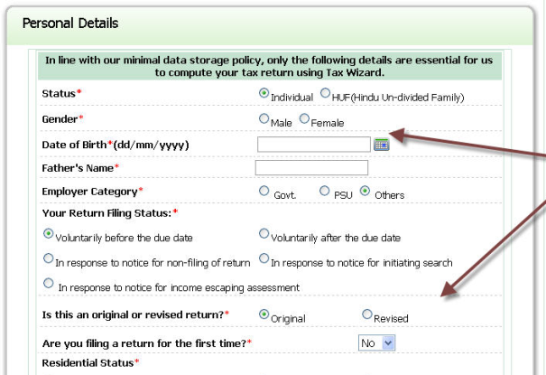
SIGN IN OR REGISTER
Easy Upload of Form 16
FORM 16
Personal Details
Add Personal Details
www.investascent.com
Download ITR V, sign and drop in the drop box
Other Income
House Property
Other income such as interest , dividend etc
Miscellaneous such as clubbing of income , agriculture
Capital gains
Check your final calculation
Tax E Filing
Add Other Income

Slide 6

Post Tax Filing Services
Excellent Follow Up
Total Employee Satisfaction
Collection of ITRV in case the corporate has opted for drop box facility
Sending the collected ITR V to an Income Tax Department
Tracking of ITRV status
Tracking of Refund Status
Revised filing incase the client has filed the returns incorrect
Rectification of returns incase the client has received any notice from Income Tax department u/s 143.

Slide 7





Pricing
Rs 150/- only per Tax E- Filing
Smart Pricing
Smart Value

Slide 8

Tax Advisory and Planning
Relationship Matters
Long Term Satisfaction
Corporate Help Desk
  In house help desk to guide the employees on Tax Planning
Tax Workshops
  To empower the employees on Tax
Private Wealth and Tax Advisors
  Employees personal wealth and tax advisors
Money Berry
  To track your investments and generate capital gains reports
Technical and Functional Support
  9 to 6 technical and functional support through phones and e mail.
Employee Sensitivity

Slide 9

Easy option to File tax returns
Self Filing :
  With our web based software, an employee can fill in the details as required and file his tax returns.
Helpdesk Filing :
  An employee can come to the helpdesk and our InvestAscent representative will file the tax returns for him.
Email E-Filing :
  An employee can also just mail us the form 16 and relax and InvestAscent team will take care of his filing.
E-Upload E- Filing :
  An employee can also just upload his form 16 in his InvestAscent account and InvestAscent team will take care of his filing.

Slide 10






















































Feedbacks
Thanks for your support.
This is the first time I am using online tool in India. I have filed US tax using TurboTax , I would say your tool is on par with that. Good Job.
Yedhu Joseph, Collabera
It has been a great experience this time out of my 16 years of IT filing. What a simple process indeed :)
Thanks to the team!!!!
N K Senthil
Hello Team,
This is a very good initiative and it has helped. It has helped in saving time and very simple steps to be followed
Vadiraj Subbarao
Team Leader - OA Ops, Thomson Reuters
I would like to highlight the excellent services offered by you and Naghma to colleagues in Noida. Filing returns this time was much more comfortable.
Thanks to you and the team
Srividya Iyer
Manager - COO MIS & Performance Analytics , Barclays Africa
I would like to thank for the excellent services provided to us while supporting and assisting us filing the ITR for this year. Much appreciated!
Sudhir Thandani, Barclays

Slide 11

Contact Us
Anuja Agrawal
Managing Director
InvestAscent Wealth Advisors Pvt Ltd
1010, 3rd Floor, 26th Main, 4th T Block,
Jayanagar, Bangalore - 560041
Tel : 080 43456565
Fax : 080 43456568
Mobile: 9901411744
anuja@investascent.com
www.investascent.com

